Slide 1
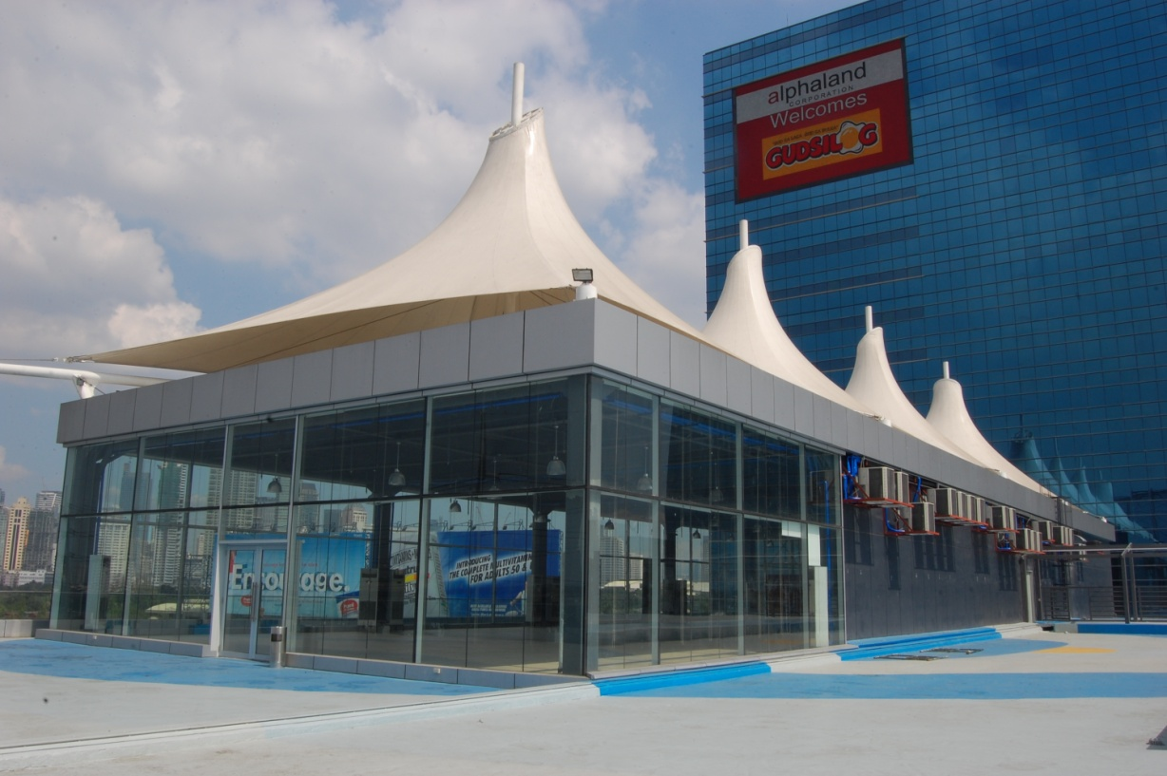
The Alpha Tents

Slide 2
Introduction
The Alpha Tents is a magnificent events place at the heart of Alphaland Southgate Tower. The Alpha Tents is a 575 sqm area that sits on the 6th floor and housed underneath the stretch of white tents in an enclosed glass structure that offers a scenic view of Makati and the Manila Bay sunset. The Alpha Tents has hosted a variety of events such as business conferences, seminars, social occasions, und raisers and several corporate and product launches, among others.

Slide 3
The Alpha Tents Amenities
Total hall area measuring 575 sq. m. with a ceiling measuring 4.6 meters in height
With 170 sq. m. al fresco area with views of the Makati skyline
Reception lobby
Fully Air Conditioned
Acoustically enhanced main hall
Private Room with Toilet and Lounge Area
100% back-up emergency power with electricity up to 300 amperes
Executive Ladies’ and Men’s comfort rooms
Two (2) service elevators for ingress and egress
Access to scenic elevator and escalator
Security, engineering, and housekeeping staff support
Secured parking space
Accessible through MRT and other public transport

Slide 4
Rates
AREA | CAPACITY |  | STANDARD RATE (5 HOURS) |  | SPECIAL RATE (10 HOURS)
 | Banquet | Cocktails/Theater | Day | Evening
From January to November
WHOLE | 350-400 pax | 500-600 pax | 80,000.00 | 100,000.00 | 130,000.00
December
WHOLE | 350-400 pax | 500-600 pax | 100,000.00 | 120,000.00 | 160,000.00
Important Provisions:
Caterer & Sound System Arrangements: For client’s account and direct coordination (NO CORKAGE FEE)
All rates are subject to 12% Value Added Tax (VAT)

Slide 5
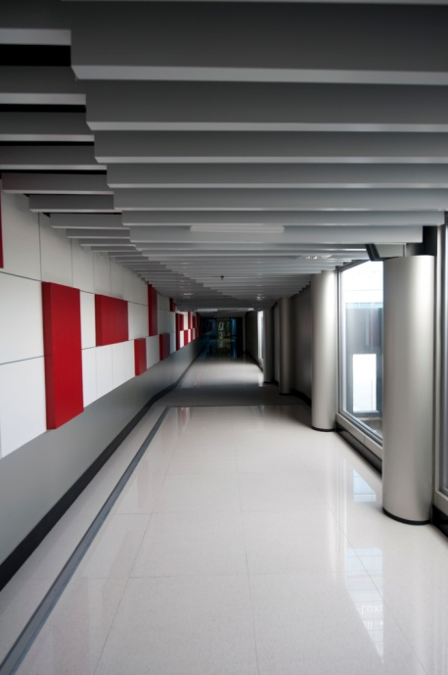
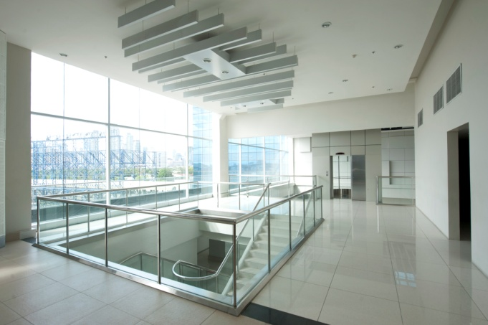
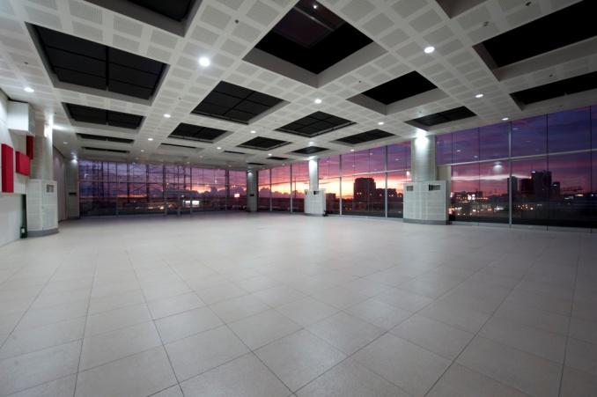
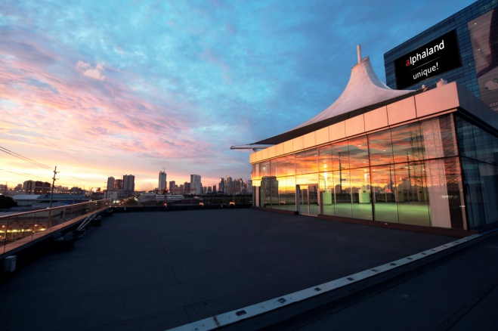
Photos
Foyer/Lobby
Walkway
Venue Hall
Al Fresco

Slide 6
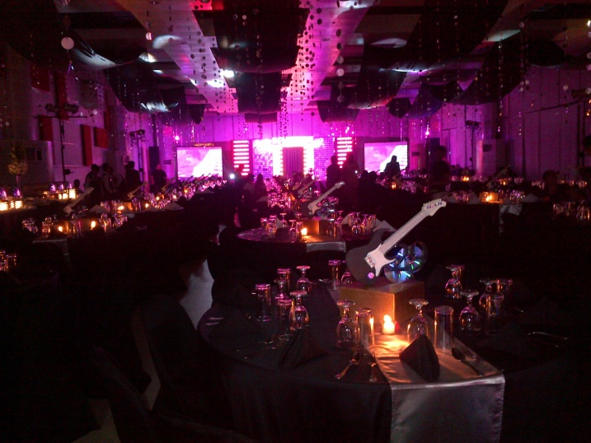
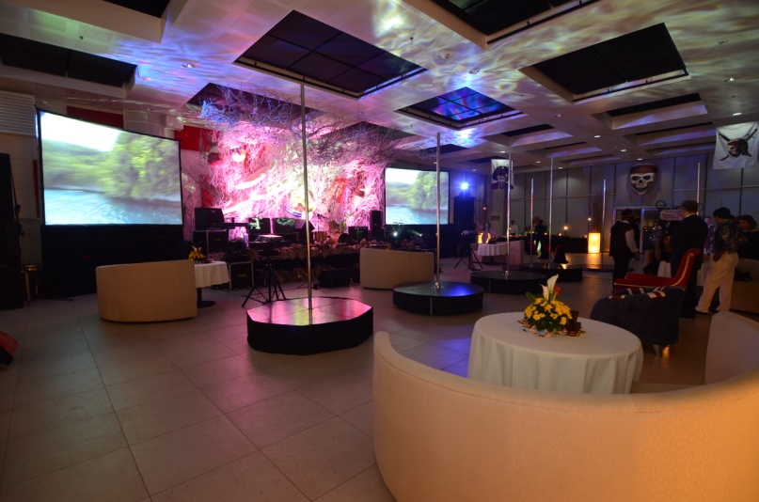
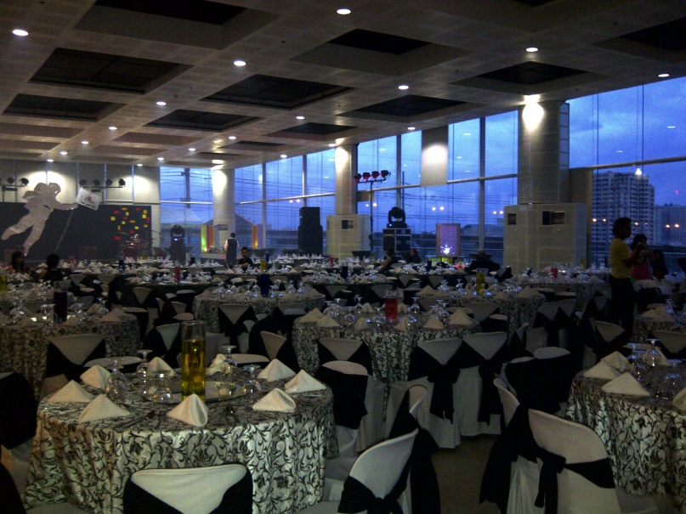
Photos

Slide 7
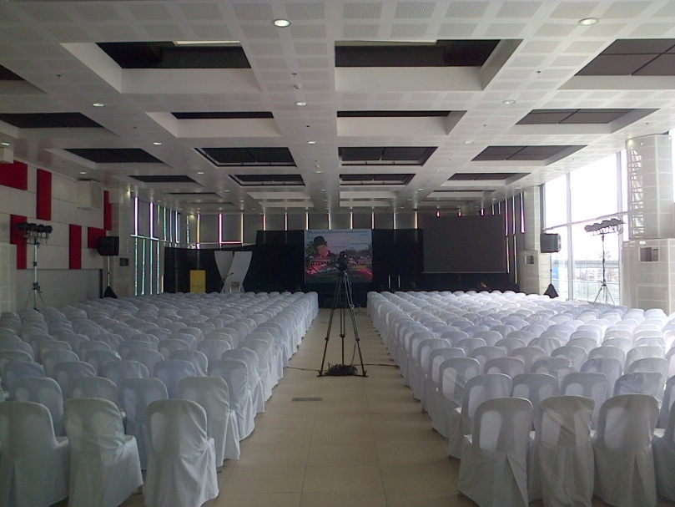
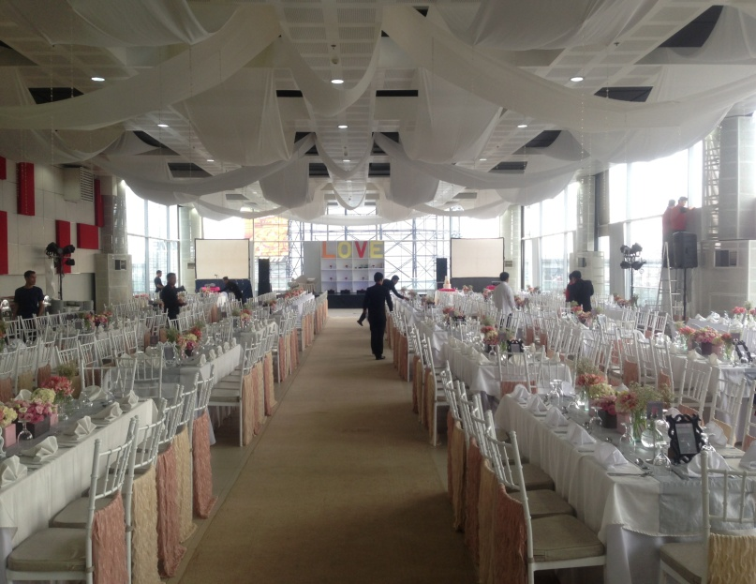
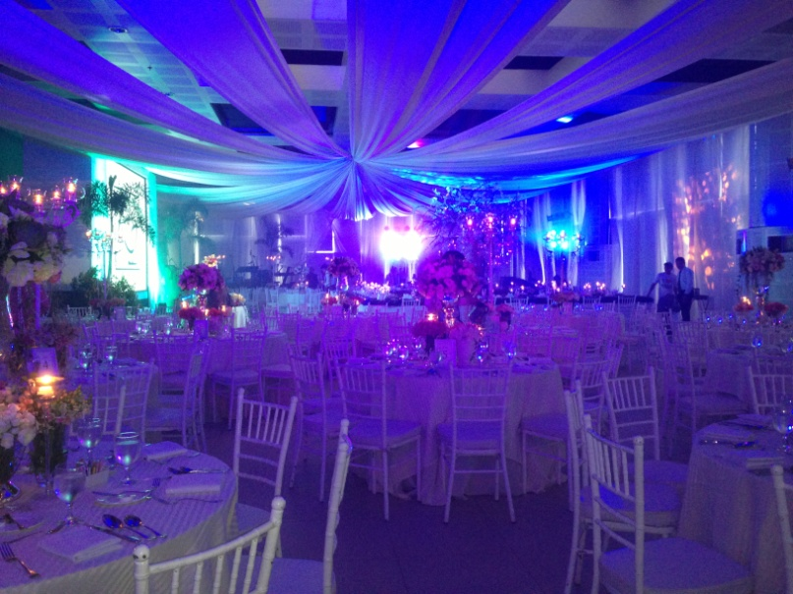
Photos

Slide 8
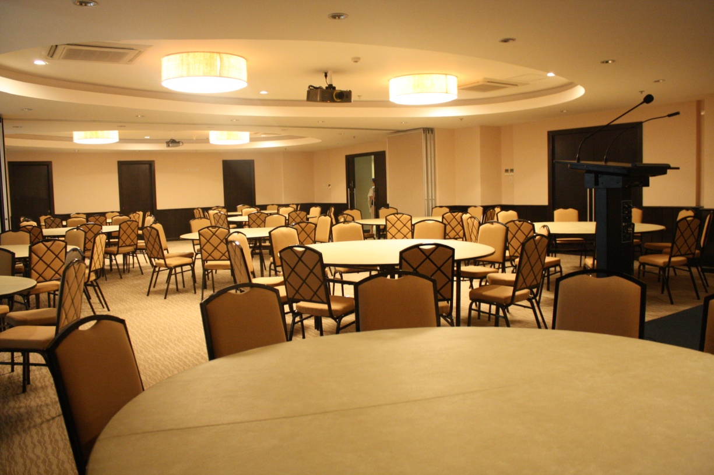
Function Rooms
Balesin and Boracay Rooms
Bali and Baguio Rooms

Slide 9
Introduction
The Alphaland Function Rooms is an elegant new space located at the 6th Floor Alphaland Southgate Tower. The function rooms can cater several types of events and offers sophisticated setting. Corporate meetings, workshops or seminars, conferences, product launches, school proms and graduation dinners, weddings, debuts, birthday parties and reunions are only some of the events that can be held in the area which can accommodate up to 170 persons.
The Alphaland Function Rooms are equipped with the latest audio visual equipment support from a motorized screen to ceiling motorized screen to ceiling-mounted LCD projectors. Wi-Fi connectivity is also available. A spacious room that is divisible into 2 smaller rooms.

Slide 10
Balesin & Boracay Rooms Features and Amenities
Fully Air conditioned
Carpeted flooring
Drop down screen and whiteboard
Wireless internet access
Platforms: 4 panels (4x8x1 ft/panel)
1 kitchen mess hall
Physical setup of function rooms with tables and chairs
Executive comfort rooms
Two (2) service elevators for ingress and egress
Security, engineering and housekeeping staff support
Secured parking space
Accessible through MRT and other public transport

Slide 11
Rates
AREA | SIZE | CAPACITY |  | STANDARD RATE
 |  | Banquet | Classroom | 4 Hours | 8 Hours
Boracay Room | 80 sqm | 50 pax | 40 pax | 12,000.00 | 17,000.00
Balesin Room | 125 sqm | 70 pax | 60 pax | 17,000.00 | 22,000.00
Boracay & Balesin Rooms | 203 sqm | 120 pax | 100 pax | 22,000.00 | 28,000.00
Other Charges (Optional) | Amount
LCD Projector | Php2,500.00
Basic Sounds System | Php3,000.00
Private Room/Lounge Area | Php5,000.00
Additional Hour(s) | Php2,500.00/Hour
Important Provisions:
Caterer & Sound System Arrangements: For client’s account and direct coordination (NO CORKAGE FEE)
All rates are subject to 12% Value Added Tax (VAT)

Slide 12
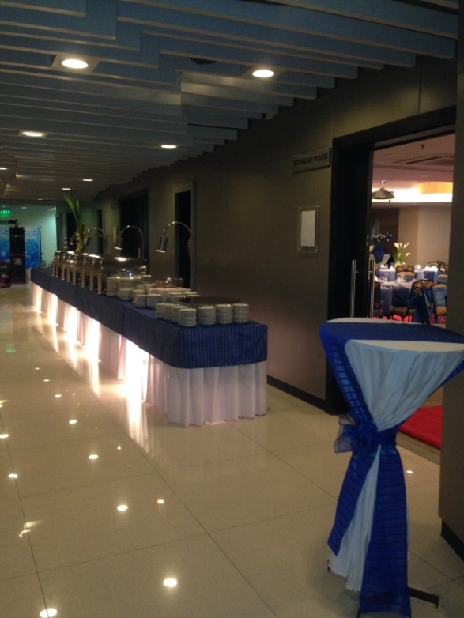
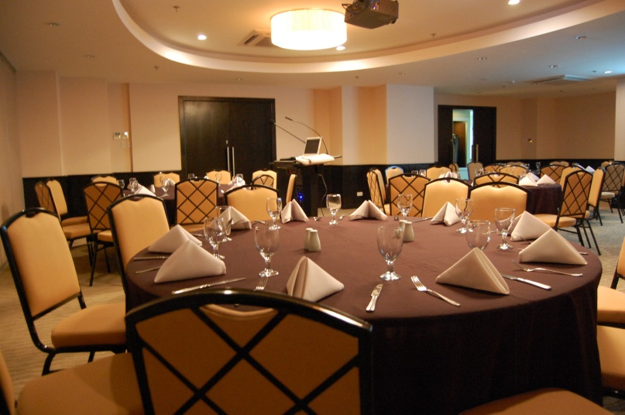
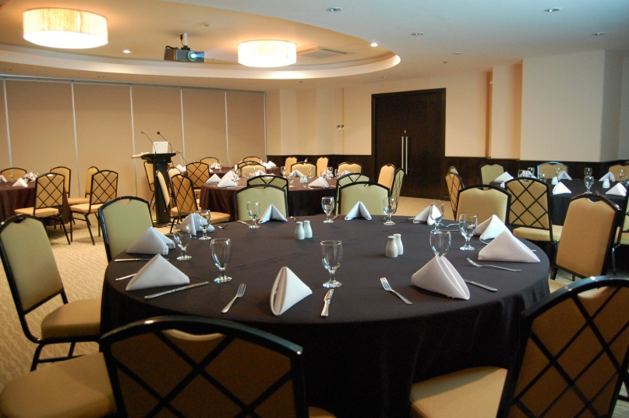
Photos

Slide 13
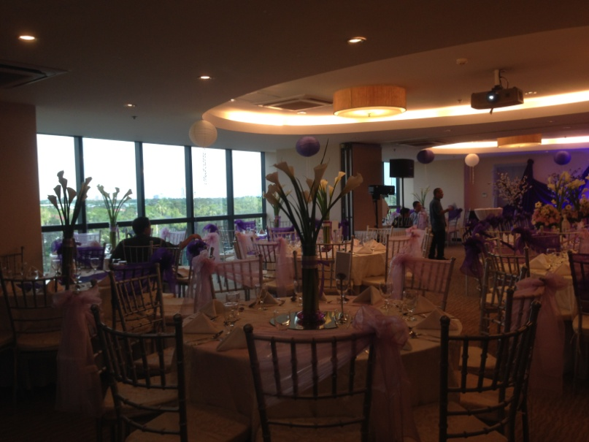
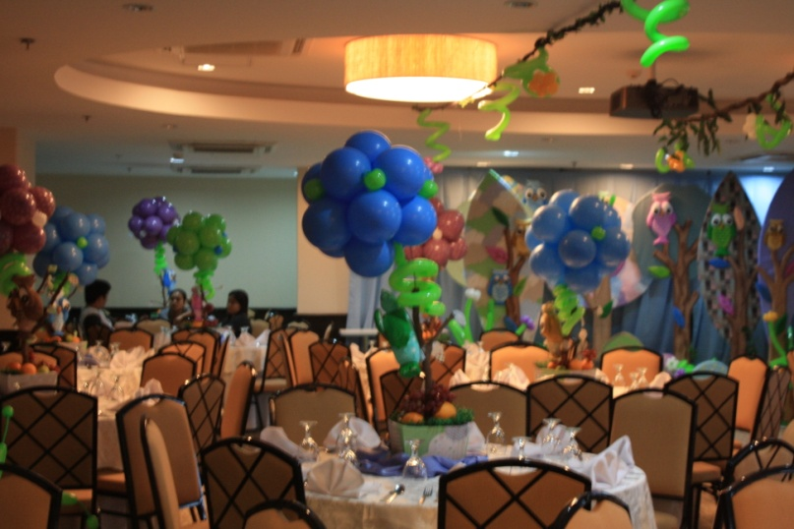
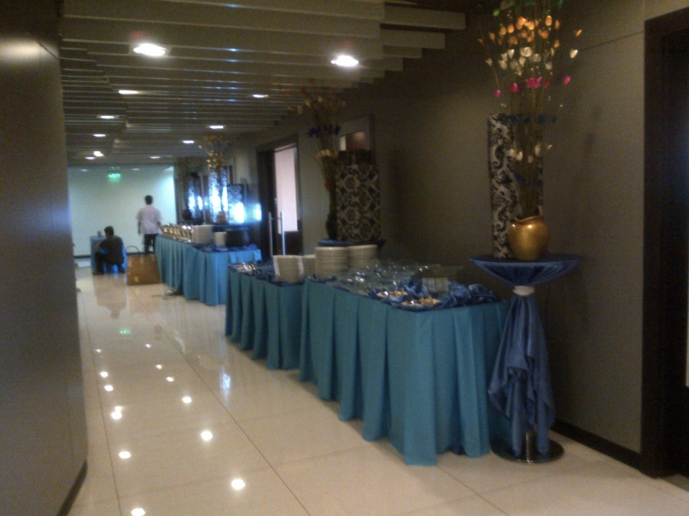
Photos

Slide 14
Bali & Baguio Function Rooms Features and Amenities
Fully Air conditioned
Carpeted flooring
Drop down screen and whiteboard
Wireless internet access
Platforms: 4 panels (4x8x1 ft/panel)
1 kitchen mess hall
Physical setup of function rooms with tables and chairs
Executive comfort rooms
Two (2) service elevators for ingress and egress
Security, engineering and housekeeping staff support
Secured parking space
Accessible through MRT and other public transport

Slide 15
Rates
AREA | SIZE | CAPACITY |  | STANDARD RATE
 |  | Banquet | Classroom | 4 Hours | 8 Hours
Bali Room | 113 sqm | 70 pax | 70 pax | 15,000.00 | 20,000.00
Baguio Room | 126 sqm | 80 pax | 80 pax | 17,000.00 | 22,000.00
Bali & Baguio Rooms | 239 sqm | 150 pax | 150 pax | 26,000.00 | 32,000.00
Other Charges (Optional) | Amount
LCD Projector | Php2,500.00
Basic Sounds System | Php3,000.00
Private Room/Lounge Area | Php5,000.00
Additional Hour(s) | Php3,000.00/Hour
Important Provisions:
Caterer & Sound System Arrangements: For client’s account and direct coordination (NO CORKAGE FEE)
All rates are subject to 12% Value Added Tax (VAT)

Slide 16
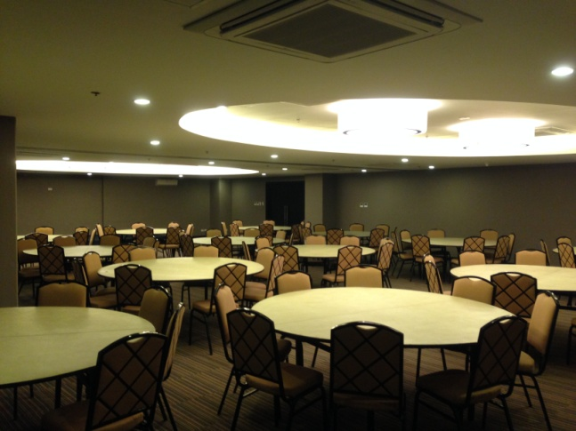
Photos

Slide 17
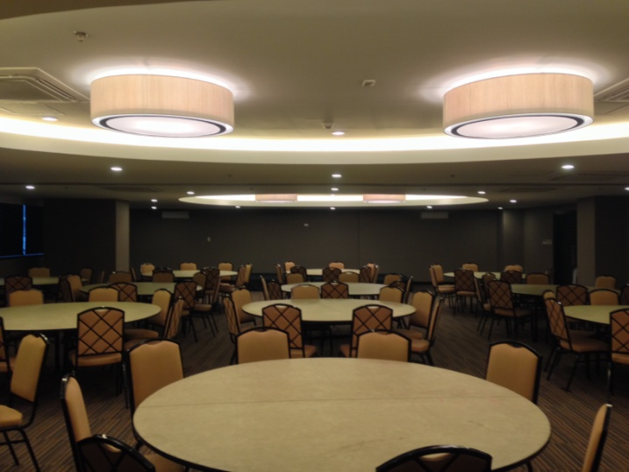
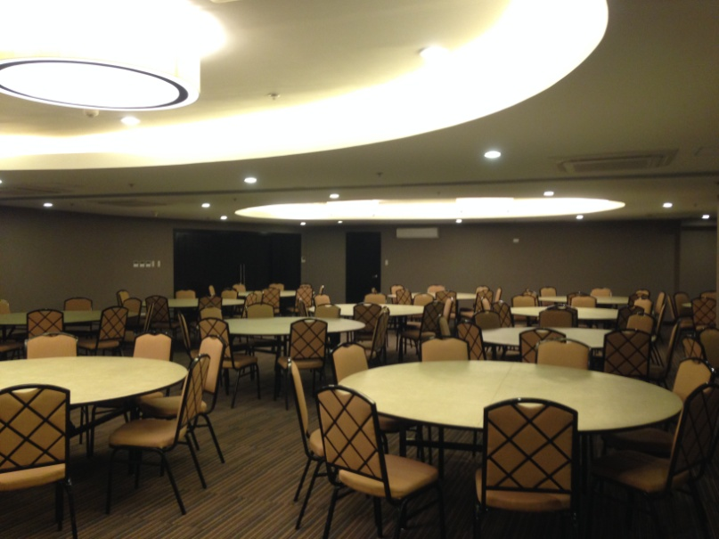
Photos

